Slide 1

Fundamentals of Programming Using C - 15101104
Unit 4 : User Defined Function
Bhavika Vaghela
Assistant Professor
Parul Institute of Computer Application
Faculty of IT & Computer Science
Parul University

Slide 2

Function in C
What is function?
Function is group of executable statement to perform some task.
A functions takes some data as input, perform some operation on that data and then may return a value.
Any C program must contain at least one function, which is main().
There is no limit on the number of functions that might be present in a C program.
Also known as subprograms which are used to compute a value or perform a specific task.
They can’t run independently and are always called by the main() program or by some other function.

Slide 3
Function in C
The function contains the set of programming statements enclosed by {}.
A function can be called multiple times to provide reusability and modularity to the C program.
In other words, we can say that the collection of functions creates a program. The function is also known as procedure or subroutine in other programming languages.

Slide 4
Advantages of Function (why to use it?)
Code reusability : we can use the function again and again once it is declared.
It called n times any where in c program.
One can divide a big program into sub program using function.
Debugging of the code would be easier if you use functions, as errors are easy to be traced.
Reduces the size of the code, duplicate set of statements are replaced by function calls.

Slide 5
Types of function
C support two types of functions
Inbuilt function
User Defined function
Library functions: These are also known as Pre defined functions
Examples are scanf(), printf(), getch(), strlen(), strcmp(), strcat(), sqrt(), pow()
User-Defined functions: User defined functions are self-contained blocks of statements which are written by the user to compute or perform a task
They can be called by the main program repeatedly as per the requirement.

Slide 6
Element of User Defined Function
C function aspects | Syntax
Function declaration | return_type function_name (argument list);
Function call | function_name (argument_list)
Function definition | return_type function_name (argument list) {function body;}

Slide 7
Function Prototype / Declaration
All Identifiers in C must be declared before they are used. This is true for functions as well as variables.
For functions, the declarations needs to be done before the first call of the function.
A function declaration specifies the name, return type, and arguments of a function.
Having the prototype available before the first use of the function allows the compiler to check that the correct number and types of arguments are used in the function call.
A return type indicating the variable that the function will be return. It may be int, float, double, char, short, void etc.
Syntax : <Return type> <function name> (parameter/argument list);

Slide 8
Function Implementation or Defination
It is the actual function that contains the code that will be executed.
Should be identical (same) to the function prototype.
Syntax : return-type function_name ( arg-type name-1,...,arg-type name-n)
return-type function_name ( arg-type name-1,...,arg-type name-n) { declarations; statements; return(expression); }

Slide 9
Cont…
General form of any function definition is:
return-type function-name(argument declarations)
{
declarations and statements
}
Return-type refers to the data type of the value being returned from the function. If the return type is omitted, int is assumed.
The values provided to a function for processing are the arguments.
The set of statements between the braces is called as the function body.

Slide 10
Simple Example to Understand UDF
#include<stdio.h> #include<conio.h> void myfun(); //prototype of function void hello_fun(); //prototype of function void main() { clrscr(); printf("\n You are in main function"); myfun(); //calling of function hello_fun(); //calling of function getch(); } //Defination of User defined function void myfun() { printf("\n You are user defined function"); //Function Body hello_fun(); //can also call function from here } void hello_fun() { printf("\n You are in hello function"); //Function Body }

Slide 11
Different aspects of function calling
Without Argument with return value
Without Argument without return value (void function)
With Argument with return value
With Argument without return value (void function)
What is argument or parameter in function?
Value which is pass in function as parameter or argument to perform some task. It of any data type like int, float, double, char etc.
**note if function return any value that mean return type of function is any datatype like int, float, char, double, long int etc…
**note : if function not return any thing mean return type of that function is void.
**Argument is not mandatory to pass but where it is required try to pass it.

Slide 12
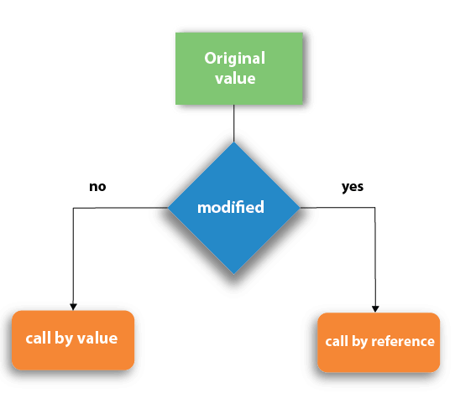
Function calling
There are two methods to pass the data into the function in C language, i.e., call by value and call by reference.
Will be discuss program later on in unit 5.

Slide 13
Recursion Function
Recursion Function means function call itself within the same function. It called recursive function, and such function calls are called recursive calls.
This concept is not applicable for every problem.
Recursion code is shorter than iterative code however it is difficult to understand.
Some argument values cause the recursive method to return without calling itself. This is the base case.
Either omitting the base case or writing the recursion step incorrectly will cause infinite recursion (stack overflow error)
Write a program to find addition of natural numbers using concept of recursion function.

Slide 14
Recursion function to find factorial of number
//proram to understand concept of recurssion call #include<stdio.h> #include<conio.h> int fact_num(int n); void main() { int n; clrscr(); printf("Enter a positive integer: "); scanf("%d",&n); printf("Factorial is %d ",fact_num(n)); getch(); } int fact_num(int n) { if (n>=1) return n*fact_num(n-1); else return 1; }

Slide 15
Passing array as an argument to function
Like a normal variable one can also pass 1D, 2D or Nd array in user defined function.
One can pass array using call by value or call by reference. (will discuss call by reference in unit 5)
One can also pass single single elements of an array into user define function.
Why to pass array in UDF?
When some one wants to pass n numbers of arguments of same data type to perform operation array is best option.

Slide 16
Program to do addition of element by passing array
Program 1 : By passing 1d array element index by index.
Program 2 : By passing whole(entire) 1D array.
Program 3 : By Passing 2D array to perform addition of elements.
Program 4 : By passing 2D array perform program for transpose matrix using UDF.
Program 5 : Perform matrix multiplication by passing array in function.
Program 6 : Perform matrix addition by passing array in function.
**likewise you can do any program by passing array as an argument to function.

Slide 17
Scope, Visibility and lifetime of variable
A scope in any programming is a region of the program where a defined variable can have its existence and beyond that variable it cannot be accessed.
Visibility : The Program’s ability to access a variable from the memory.
LifeTime : The lifetime of a variable is the duration of time in which a variable exists in the memory during execution.
There are three places where variables can be declared in C programming language −
Inside a function or a block which is called local variables.
Outside of all functions which is called global variables.
In the definition of function parameters which are called formal parameters.

Slide 18
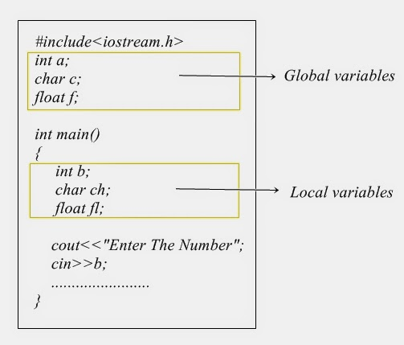
Cont…

Slide 19
lifetime of variable
The lifetime of a variable is the period of time in which the variable is allocated a space (i.e., the period of time for which it “lives”).
There are four lifetimes in C: Or Storage Classes :
It is required when we declare any variable
Four Types of Classes are there
Automatic
Register
Static
External
**please refer unit 1 for storage class or variable type

Slide 20
Scope Rules
Global variable is the entire program file.
Scope of local variable is only up to the block in which it is declare.
Scope of formal function argument is its own function.
Scope of auto variable is up to entire program execution time. Its scope is only in the main function.
Scope of static variable is limited up to the function call. Its lifetime extends till the program is executing.

Slide 21
Structure in C

Slide 22
Structure in C
Structure is user defined data type.
It is like an array it allow to combine numbers of data of same data type that is why it called homogenous.
While structure is use to combine numbers of data of different data type that is why it called heterogeneous.
All the elements of a structure are stored at contiguous memory locations.
A structure is a user defined data type that groups logically related data items of different data types into a single unit.
A variable of structure type can store multiple data items of different data types under the one name
Example : employee have name, age, salary, designation, company name, blood group, phone number, address etc,

Slide 23
Cont…
To declare structure struct keyword is use followed by structure name.
Syntax : struct <name of structure> { datatype <variable name>; datatype <variable name>; datatype <variable name>; …….. …….. …….. }; | Example : struct employee { int emp_id; char name[20]; float salary; char address[50]; int dept_no; int age; };

Slide 24
Memory Representation of Structure
Memory address (starting address) | Member of Sturucture | Size occupy
8000 | int emp_id; | 2 byte
8002 | char name[20]; | 1 byte * 20 = 20 byte
8022 | float salary; | 4 byte
8026 | char address[50]; | 1 byte * 50 = 50 byte
8076 | int dept_no; | 2 byte
8078 | int age; | 2 byte

Slide 25
Declaring variable of structure
There are two way to declare structure variable
Outside of structure (mean in function) main() { struct <struct name> s1,s2; } Example : void main() { struct student s1,s2,s3; } Program 1 | 2) At the end of structure struct <structure name> { datatype variable; datatype variable; ……….. } var1,var2…; Example : struct student { int rollnum; char name[20]; long int phone; ……… } s1,s2,s3; Program 2

Slide 26
Initializing structure variable (data member of structure)
We can not initialize the member or element of structure at the declaration time or inside the structure
The members of individual structure variable is initialize one by one or in a single statement after the structure declaration. The example to initialize a structure variable is
struct employee e1 = {1, “Hemant”,12000.00, “3 vikas colony new delhi”,10, 35);
Or
e1.emp_id=1;
e1.name=“Arpankumar”; //not possible without using strcpy() function
e1.salary=12000; e1.dept_no=1
e1.address=“ Parul University”;

Slide 27
Accessing Members of structure
For accessing member of structure have to use (.) operator followed by variable of structure and member of structure.
The structure members cannot be directly accessed in the expression.
They are accessed by using the name of structure variable followed by a dot and then the name of member variable.
The method used to access the structure variables are
e1.emp_id, e1.name, e1.salary, e1.address, e1.dept_no, e1.age.
The data with in the structure is stored and printed by this method using scanf and printf statement in c program.

Slide 28
Structure Assignment
The value of one structure variable is assigned to another variable of same type using assignment statement. If the e1 and e2 are structure variables of type employee then the statement.
e1 = e2;
Assign value of structure variable e2 to e1. The value of each member of e2 is assigned to corresponding members of e1.
Please go with attached program in slide no 25.

Slide 29
Array of Structure
C language allows to create an array of variables of a structure.
The array of structure is used to store the large number of similar records.
For example to store the record of 100 employees then array of structure is used.
The method to define and access the array element of array of structure is similar to other array.
The syntax to define the array of structure is,
struct <struct_name> <array_var_name> [<value>];
For Example:-
struct employee e1[100];
Program for array of structure

Slide 30
Structure within structure or nested structure
Nested Structure mean : structure within structure.
C language define a variable of structure type as a member of other structure type. The syntax to define the structure within structure is
struct <struct_name>
{ <data_type> <variable_name>;
struct <struct_name>
{ <data_type> <variable_name>;
……..
}<struct_variable>;
<data_type> <variable_name>;
};

Slide 31
Example of nested structure
struct employee { int empid; char name[20]; struct date { int day; int month; int year; }day; float salary; char designation }; | struct student { int stdid; struct name { char fname[15]; char mname[15]; char lname[15]; }sname; long int phone_no; struct qualification { float hse; float ssc; }per; };
Program of nested Structure

Slide 32
Accessing data member of nested structure
The data member of structure within structure is accessed by using two period (.) symbol. The syntax to access the structure within structure is
struct _var. nested_struct_var. struct_member;
For Example:-
e1.doj.day;
e1.doj.month;
e1.doj.year;
Here e1 is variable of structure employee and doj is variable of date structure.

Slide 33
Structure as an argument of UDF
As we have two types of function inbuilt and user defined so one can also pass variable of structure as an argument of user defined function.
For this create variable of structure either inside the main function or at the end of structure and pass that variable as an argument of function.
If you declare variable at the end of structure than there is no need to pass it as an argument because it become global variable and global variable is accessible every where through out the program.
So by passing structure variable as an argument you can read and print the data for structure. Even you can also perform some calculation. Please find program for the same. In next slide.

Slide 34
Program to pass structure variable in udf
Program to pass structure variable as an function argument.
Program of employee with the same concept.
Program to pass array of structure as an function argument.
Program to return structure as a return type of user defined function.

Slide 35
Union
A union is a user defined data type like structure.
The union groups logically related variables into a single unit.
The union data type allocate the space equal to space need to hold the largest data member of union.
The union allows different types of variable to share same space in memory.
There is no other difference between structure and union than internal difference.
The method to declare, use and access the union is same as structure.
Keyword union is use to declare union. Only difference between union and structure is memory allocation.

Slide 36
Union
How to declare union?
Syntax : union <union_name> { <data_type> <variable_name>; <data_type> <variable_name>; …….. <data_type> <variable_name>; }var_name; | Example : union employee { int emp_id; char name[20]; float salary; char address[50]; int dept_no; int age; };

Slide 37
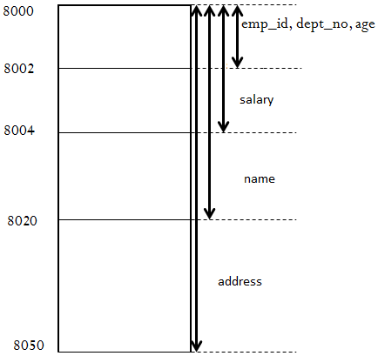
Memory allocation of union
Program to find sizeof structure and union variable so that you will get to know how memory allocation id different.

Slide 38
Programs of Union
Program which shows the memory representation of union.
Program to read and print data member of union.
Program to pass union as an argument of function.
Program to create array of union.
**same as structure you can also create nested union
Nested union : union within a union same like structure.
Program of nested union.

